Slide 1
Step by step instructions to assist you in registering with NMVTIS
Created by: Dealer Licensing
DealerLicensing.BMV@Maine.gov

Slide 2
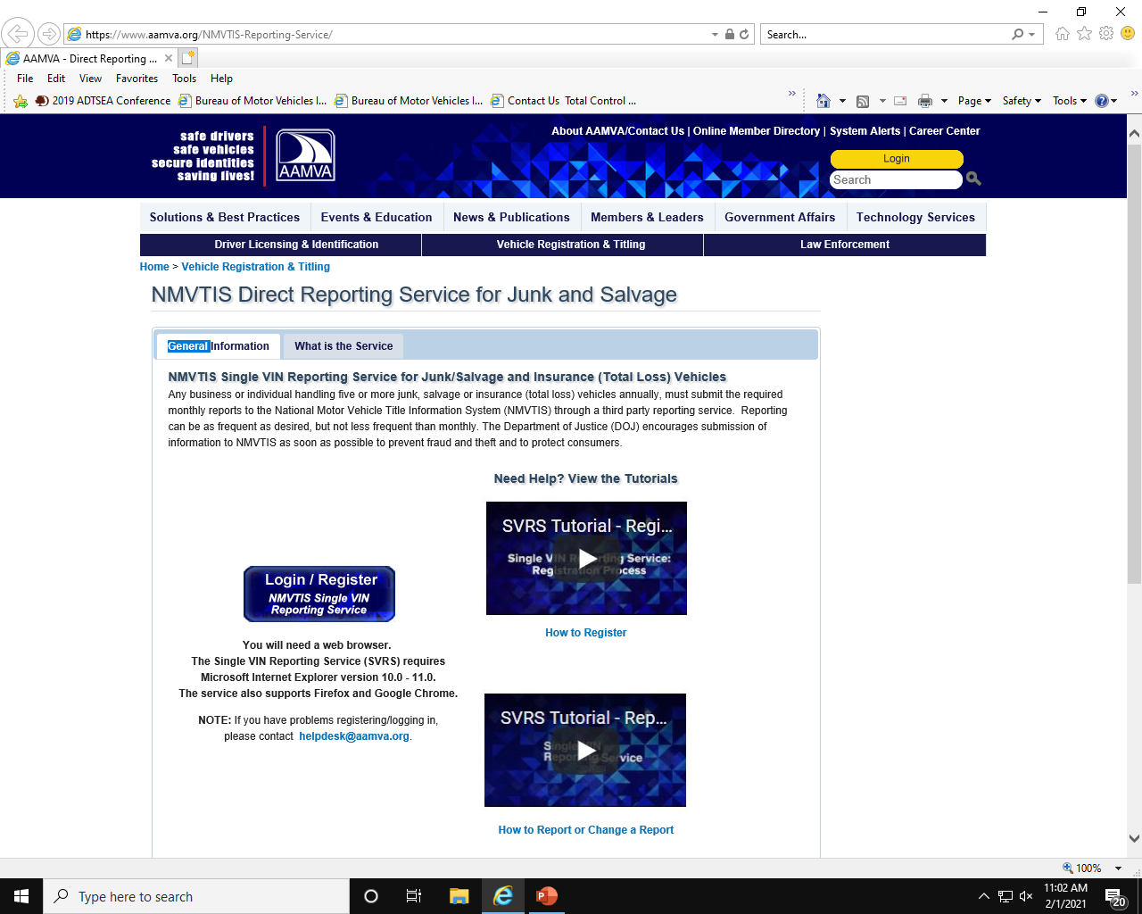
Step 1
Click on or copy and paste this link to your web browser: https://www.aamva.org/NMVTIS-Reporting-Service/
When the website opens, click on the blue Login/Register button.

Slide 3
Step 2
Please find the “New Customers Must Register Here” and click the blue “Register” button in the lower right corner.

Slide 4
Step 3
Next you will verify that your business has an EIN by clicking “Yes” and then click “Next” in the lower right corner.

Slide 5
Step 4
You have not yet been issued a “Reporting Entity ID” so you will choose the second option, “No”, by clicking the “Register Now” button.

Slide 6
Step 5
Please fill in the fields highlighted and then click the “Register” button in the lower right corner.

Slide 7
Step 6
You have now registered with NMVTIS. Please click the “Finish” button on the right and proceed to “Activate” your account. In order to activate your account, you will need to log into the email address you used to create the NMVTIS account and locate the email with the subject “NMVTIS New Entity Registration Information”. See the next slide for more information.

Slide 8
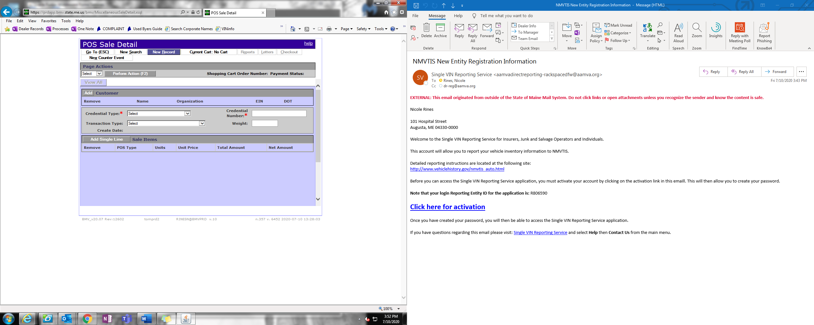
Step 7
This is what you will find in the email from NMVTIS. Please record your “Reporting Entity ID”, see sample below, then click the “Click here for activation” button.

Slide 9
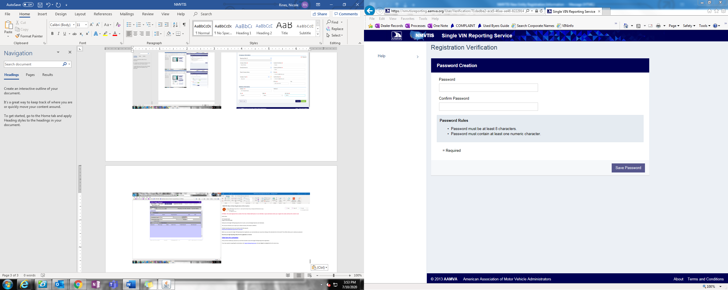
Step 8
Please enter and record a password that is 8 characters, one character must be a number. Confirm the password by re-entering the password and click “Save Password”. (Now you should have the Reporting Entity ID and Password recorded for future use.)

Slide 10
Step 9
In the upper right corner, you should now see your business name or your first and last name. Beside that, you should see a silhouette of a man. Click the silhouette, if it appears, if not, click your business name or your first and last name.

Slide 11
Step 10
A drop-down menu should appear, click “Registration”.

Slide 12
Step 11
You have now completed the registration and activation process with NMVTIS. Please print the screen, or screen shot and paste into an email, in order to submit to the Bureau of Motor Vehicles, Dealer Licensing, as proof of registration and activation with NMVTIS. Please email to DealerLicensing.BMV@Maine.gov or fax to 207-624-9126.

Slide 13
Questions????
Please feel free to contact Dealer Licensing if you have any questions regarding this process at DealerLicensing.BMV@Maine.gov or 207-624-9000 ext. 52143.
As soon as we receive the email or fax confirming registration and activation with NMVTIS, you will be in compliance with this requirement.
Thank you!

